Slide 1
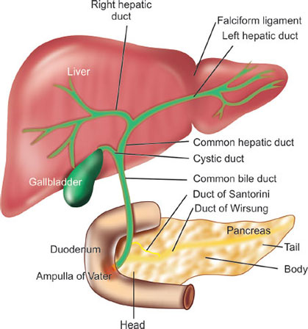
Adult Nursing(2nd Stage)
Hepatobiliary Disorders
Lecture 6
By
Assistant. Lecturer. Khadija Mohammed Jassim
Fundamentals of Nursing Department
College of Nursing
University of Basrah
University of Basrah –College of Nursing – Fundamentals of Nursing Department

Slide 2
Anatomy of the Liver
The liver is a large, highly vascular organ located behind the ribs in the
upper right portion of the abdominal cavity. It weighs between 1200 and
1500 g in the average adult and is divided into four lobes.
A thin layer of connective tissue surrounds each lobe, extending into the lobe itself and dividing the liver mass into small, functional units called lobules.
University of Basrah –College of Nursing– Fundamentals of Nursing Department
2

Slide 3
The circulation of the blood into and out of the liver is of major importance to liver function. The blood that perfuses the liver comes from two sources.
Approximately 80% of the blood supply comes from the portal vein, which drains the GI tract and is rich in nutrients but lacks oxygen.
The remainder of the blood supply enters by way of the hepatic artery and is rich in oxygen.
University of Basrah –College of Nursing– Fundamentals of Nursing Department
3

Slide 4
Functions of the Liver
Glucose Metabolism
Ammonia Conversion
Protein Metabolism
Fat Metabolism
Vitamin and Iron Storage
Bile Formation
Bilirubin Excretion
Drug Metabolism
University of Basrah –College of Nursing– Fundamentals of Nursing Department
4

Slide 5
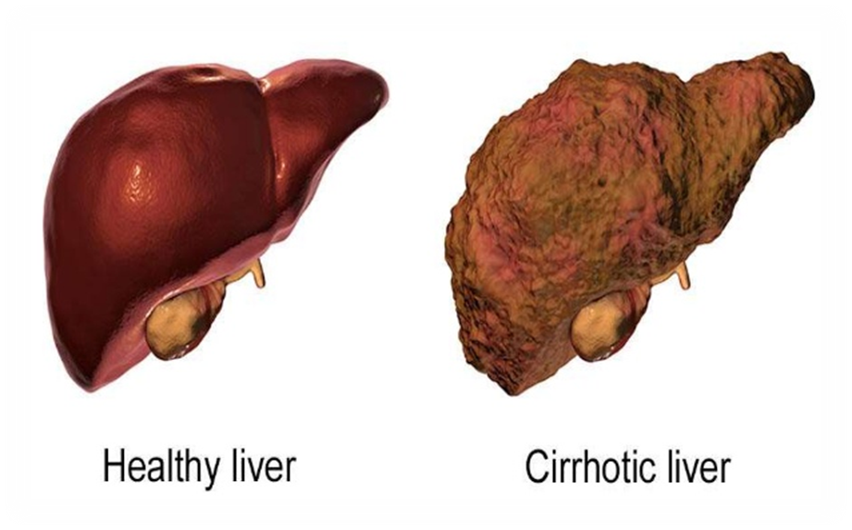
Hepatic Cirrhosis
Cirrhosis is a chronic disease characterized by replacement of normal liver tissue with diffuse fibrosis that disrupts the structure and function of the liver.
University of Basrah –College of Nursing– Fundamentals of Nursing Department
5

Slide 6
There are three types of cirrhosis or scarring of the liver:
Alcoholic cirrhosis: in which the scar tissue characteristically surrounds the portal areas. This is most frequently caused by chronic alcoholism and is the most common type of cirrhosis.
Post necrotic cirrhosis: in which there are broad bands of scar tissue. This is a late result of a previous bout of acute viral hepatitis.
Biliary cirrhosis: in which scarring occurs in the liver around the bile ducts. This type of cirrhosis usually results from chronic biliary obstruction and infection (cholangitis); it is much less common.
University of Basrah –College of Nursing– Fundamentals of Nursing Department
6

Slide 7
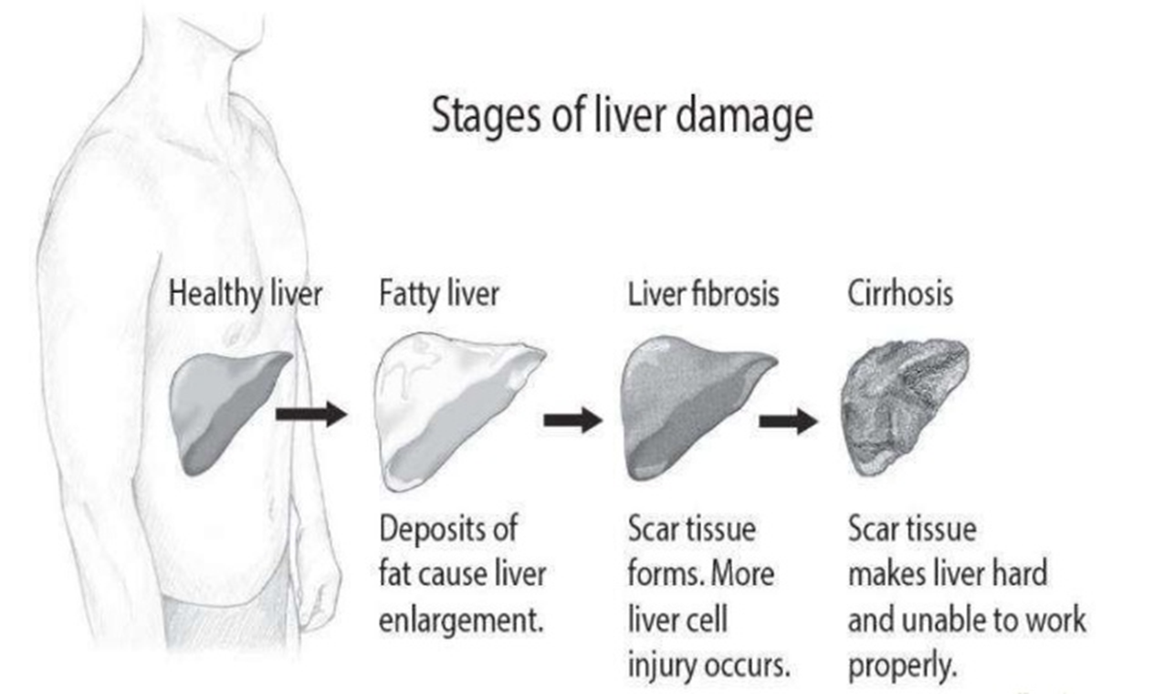
University of Basrah –College of Nursing– Fundamentals of Nursing Department
7

Slide 8
Clinical Manifestations
Compensated
Abdominal pain 7. Unexplained epistaxis
Ankle edema 8. Vague morning indigestion
Firm, enlarged liver 9. Vascular spiders
Flatulent dyspepsia 10. Splenomegaly
Intermittent mild fever
Palmar erythema (reddened palms)
University of Basrah –College of Nursing– Fundamentals of Nursing Department
8

Slide 9
Decompensated
Ascites 10. Sparse body hair
Clubbing of fingers 11. Spontaneous bruising
Continuous mild fever 12. Weakness
Epistaxis 13. Weight loss
Gonadal atrophy 14. White nails
Hypotension
Jaundice
Muscle wasting
Purpura (due to decreased platelet count)
University of Basrah –College of Nursing– Fundamentals of Nursing Department
9

Slide 10
Assessment and Diagnostic Findings
Increase serum globulin , serum alkaline phosphatase, AST, ALT, and GGT, Bilirubin tests are performed to measure bile excretion or bile retention; elevated levels can occur with cirrhosis and other liver disorders
Decrease serum albumin , serum cholinesterase
Prothrombin time is prolonged.
- Ultrasound scanning CT, MRI, and radioisotope liver scans ,liver biopsy, Arterial blood gas analysis .
University of Basrah –College of Nursing– Fundamentals of Nursing Department
10

Slide 11
Medical Management
The management of the patient with cirrhosis is usually based on the presenting symptoms. For example:
1- antacids are prescribed to decrease gastric distress and minimize the possibility of GI bleeding.
2- Vitamins and nutritional supplements promote healing of damaged liver cells and improve the general nutritional status.
3- Potassium-sparing diuretics [Aldactone], may be indicated to decrease ascites.
4- An adequate diet and avoidance of alcohol are essential.
University of Basrah –College of Nursing– Fundamentals of Nursing Department
11

Slide 12
Nursing Diagnoses
1-Activity intolerance related to fatigue, general debility, muscle wasting, and discomfort .
2-Imbalanced nutrition, less than body requirements, related to chronic gastritis, decreased GI motility, and anorexia.
3- Impaired skin integrity related to compromised immunologic status, edema, and poor nutrition.
4-Risk for injury and bleeding related to altered clotting mechanisms.
University of Basrah –College of Nursing– Fundamentals of Nursing Department
12

Slide 13
Nursing Interventions
1-Encourage rest when fatigued or when abdominal pain or discomfort occurs.
2-Administer supplemental vitamins (A, B complex, C, and K).
3-Provide diet high in carbohydrates with protein intake consistent with liver function
4-Administer medications prescribed for nausea, vomiting, diarrhea, or constipation.
5- Encourage increased fluid intake and exercise if the patient reports constipation.
6- Keep patient’s fingernails short and smooth.
University of Basrah –College of Nursing– Fundamentals of Nursing Department
13

Slide 14
7-Provide frequent skin care; avoid use of soaps and alcohol-based lotions
8-Restrict sodium as prescribed.
9-Perform range of motion exercises every 4 hours; elevate edematous extremities whenever possible.
10-Observe for hemorrhagic manifestations: ecchymosis, epistaxis, petechiae, and bleeding gums.
11-Record vital signs at frequent intervals, depending on patient acuity (every 1–4 hours).
12-Administer vitamin K as prescribed.
13-Administer medications carefully; monitor for side effects.
University of Basrah –College of Nursing– Fundamentals of Nursing Department
14

Slide 15
Potential Complications
Bleeding and hemorrhage
Hepatic encephalopathy
Fluid volume excess
University of Basrah –College of Nursing– Fundamentals of Nursing Department
15

Slide 16
Anatomy Of The Gallbladder
The gallbladder, a pear-shaped, hollow, saclike organ that is 7.5 to 10 cm (3 to 4 inches) long, lies in a shallow depression on the inferior surface of the liver, to which it is attached by loose connective tissue.
The capacity of the gallbladder is 30 to 50 mL of bile. Its wall is composed largely of smooth muscle. The gallbladder is connected to the common bile duct by the cystic duct.
University of Basrah –College of Nursing– Fundamentals of Nursing Department
16

Slide 17
The gallbladder functions
The gallbladder functions as a storage depot for bile. Between meals, when the sphincter of Oddi is closed, bile produced by the hepatocytes enters the gallbladder.
During storage, a large portion of the water in bile is absorbed through the walls of the gallbladder; thus, bile in the gallbladder is 5 to 10 times more concentrated than that originally secreted by the liver.
University of Basrah –College of Nursing– Fundamentals of Nursing Department
17

Slide 18
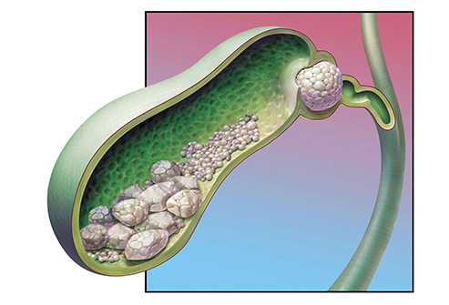
Cholelithiasis
gallstones are collections of cholesterol, bile pigment or a combination of the two , which can form in the gallbladder or within the bile ducts of the liver.
University of Basrah –College of Nursing– Fundamentals of Nursing Department
18

Slide 19
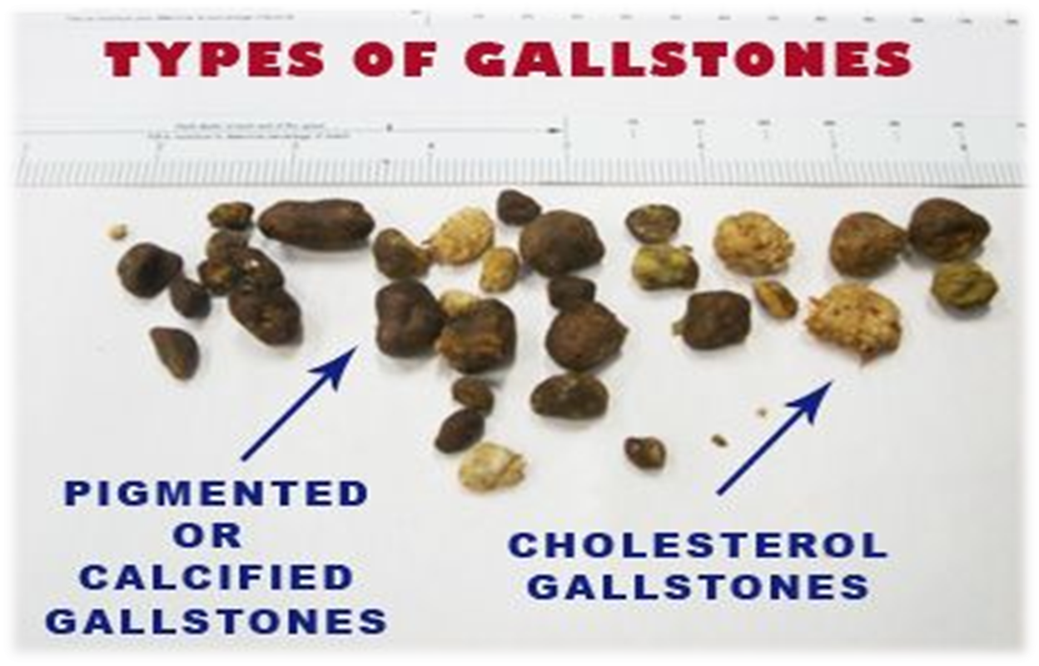
There are two major types of gallstones:
Cholesterol stones: most common type, increase with age , female more male , smooth & whitish yellow to tan color.
Pigmented stones: excess of unconjugated bilirubin, may be black color (associated with hemolysis and cirrhosis) .
University of Basrah –College of Nursing– Fundamentals of Nursing Department
19

Slide 20
Etiology
Gallstones occur most in women, from aging, obesity, pregnancy, stasis of bile, fasting, medications, and heredity.
Stasis may be caused by a decreased gallbladder-emptying rate, a partial obstruction in the common duct, or pregnancy.
University of Basrah –College of Nursing– Fundamentals of Nursing Department
20

Slide 21
Clinical Manifestations
The patient with gallbladder disease resulting from gallstones may develop two types of symptoms: those due to disease of the gallbladder itself :
Epigastric distress, such as fullness.
abdominal distention.
vague pain in the right upper quadrant of the abdomen. may occur.
This distress may follow a meal rich in fried or fatty foods.
University of Basrah –College of Nursing– Fundamentals of Nursing Department
21

Slide 22
those due to obstruction of the bile passages by a gallstone:
Pain and Biliary Colic.
Jaundice.
Changes in Urine and Stool Color.
Vitamin Deficiency
University of Basrah –College of Nursing– Fundamentals of Nursing Department
22

Slide 23
Diagnostic Tests
1. Physical examination.
2. Laboratory test:
Elevated conjugated bilirubin.
Elevated alkaline phosphate.
Serum amylase and lipase.
Elevated WBC .
3. Ultrasound of the gallbladder.
4. CT scan.
University of Basrah –College of Nursing– Fundamentals of Nursing Department
23

Slide 24
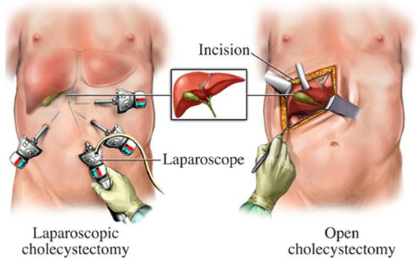
Surgical management
Open cholecystectomy.
Laparoscopic cholecystectomy.
University of Basrah –College of Nursing– Fundamentals of Nursing Department
24

Slide 25
Nursing diagnosis
Acute pain and discomfort related to surgical incision
Impaired gas exchange related to the high abdominal surgical incision (if traditional surgical cholecystectomy was performed)
Impaired skin integrity related to altered biliary drainage after surgical intervention (if a T-tube was inserted because of retained stones in the common bile duct or another drainage device was employed)
Imbalanced nutrition: less than body requirements related to inadequate bile secretion
Deficient knowledge about self-care activities related to incision care, dietary modifications (if needed), medications, and reportable signs or symptoms (e.g., fever, bleeding, vomiting).
Potential Complications
Bleeding
GI symptoms (may be related to biliary leak or injury to the bowel)
University of Basrah –College of Nursing– Fundamentals of Nursing Department
25

Slide 26
Nursing intervention
Relieving Pain
Improving Respiratory Status
Maintaining Skin Integrity And Promoting Biliary Drainage
Improving Nutritional Status
Monitoring And Managing Potential Complications
University of Basrah –College of Nursing– Fundamentals of Nursing Department
26

Slide 27
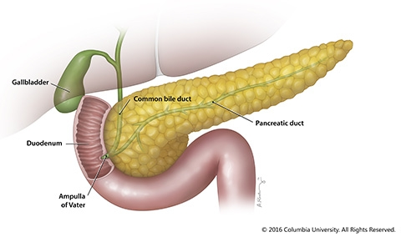
The Pancreas
The pancreas is located in the upper abdomen. It has both:
Exocrine (secreting externally; enzyme secretion) .
Endocrine (secreting internally; hormonal secretion).
University of Basrah –College of Nursing– Fundamentals of Nursing Department
27

Slide 28
The exocrine functions include secretion of pancreatic enzymes into the gastrointestinal (GI) tract through the pancreatic duct.
The endocrine functions include secretion of insulin, glucagon, and somatostatin directly into the bloodstream.
Pancreatic enzymes
Pancreatic enzymes include:
Amylase, which aids in the digestion of carbohydrates.
Trypsin, which aids in the digestion of proteins.
Lipase, which aids in the digestion of fats.
Other enzymes that promote the breakdown of more complex foodstuffs are also secreted.
University of Basrah –College of Nursing– Fundamentals of Nursing Department
28

Slide 29
Pancreatitis
Pancreatitis (inflammation of the pancreas) is a serious disorder.
pancreatitis divides the disorder into acute and chronic forms:
Acute pancreatitis ranges from a mild, self-limited disorder to a severe, rapidly fatal disease that does not respond to any treatment.
These two main types of acute pancreatitis (mild and severe) are classified as interstitial
edematous pancreatitis and necrotizing pancreatitis, respectively.
Chronic pancreatitis is an inflammatory disorder characterized by progressive destruction of the pancreas.
Alcohol consumption in Western societies and malnutrition worldwide are the major causes of chronic pancreatitis.
University of Basrah –College of Nursing– Fundamentals of Nursing Department
29

Slide 30
Clinical Manifestations
dull abdominal pain, guarding, a rigid abdomen.
hypotension or shock.
respiratory distress from accumulation of fluid in the retroperitoneal space.
epigastric or lower upper quadrant (LUQ) pain.
weight loss.
anorexia.
Low-grade fever.
Nausea and vomiting
University of Basrah-College of Nursing– Fundamentals of Nursing Department
30

Slide 31
Diagnostic Tests
Elevated serum amylase.
Elevated serum lipase.
Elevated white blood cell count (WBC) due to inflammation.
Elevated cholesterol.
Elevated glucose due to labile effect on glucose control.
Elevated bilirubin.
CT scan shows inflammation.
Chest x-ray may show pleural effusion.
University of Basrah –College of Nursing– Fundamentals of Nursing Department
31

Slide 32
Treatment of AP
Early aggressive IV hydration during the first 24 hours for hypovolemia treatment is recommended.
In asymptomatic mild acute pancreatitis, oral nutrition is given,in severe cases, enteral feeding is maintained.
A histamine (H2) antagonist can help decrease acid stimulation of pancreatic secretions.
Additional drug orders include electrolytes such as calcium and magnesium to replace losses.
Insulin treatment hyperglycemia.
Surgery may be needed for debriding necrotic tissue. Abscesses or pseudocysts may need to be drained.
University of Basrah –College of Nursing– Fundamentals of Nursing Department
32

Slide 33
Treatment of CP
Treatment is aimed at promoting comfort and maintaining adequate nutrition.
Pain is managed with analgesics.
Surgery may be necessary to treat biliary disease, repair fistulas, drain cysts, or repair other damage.
University of Basrah –College of Nursing– Fundamentals of Nursing Department
33

Slide 34
Nursing diagnosis
Pain and discomfort R/T edema and distention of the pancreas.
Imbalanced Nutrition less than body requirement R/T nausea and vomiting.
Risk for Ineffective Breathing Pattern R/T accumulation of fluid.
Activity intolerance R/T fatigue.
Impaired skin integrity R/T surgical wound.
University of Basrah –College of Nursing– Fundamentals of Nursing Department
34

Slide 35
Nursing Intervention
Assess vital signs (elevated temperature, pulse , changes in blood pressure).
Assess pain level.
Monitor intake and output.
Assess abdomen for bowel sounds, tenderness, masses, ascites.
Monitor blood glucose level.
Assess lung sounds for bilateral equality.
University of Basrah –College of Nursing– Fundamentals of Nursing Department
35

Slide 36
University of Basrah –College of Nursing– Fundamentals of Nursing Department
36

